Slide 1
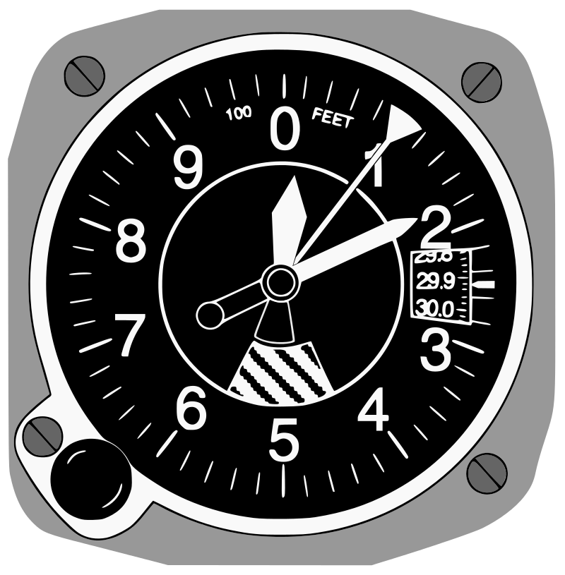
Altimeter
Shortest:-1000 ft
Long:-10,000 ft
Medium:-100 ft
Kollsman Window
Barometric Adjust Knot

Slide 2
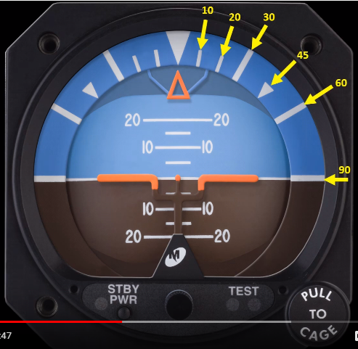
Attitude Indicator
Bank Angle
Pitch in Angle
Blue Sky
Horizon
Representation
Brown Earth
Pitch Indicator

Slide 3
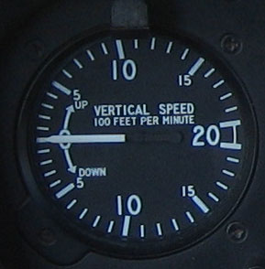
Vertical Speed Indicator
Reading here:- 100*6=600 feet/min
Upper Half
Climbing
Level Flight
Lower Half
Descending

Slide 4
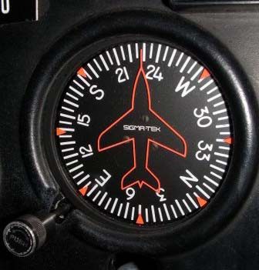
Airplane image Fixed
Rotatable Circular Azimuth Card
Caging Knob to rotate the card

Slide 5
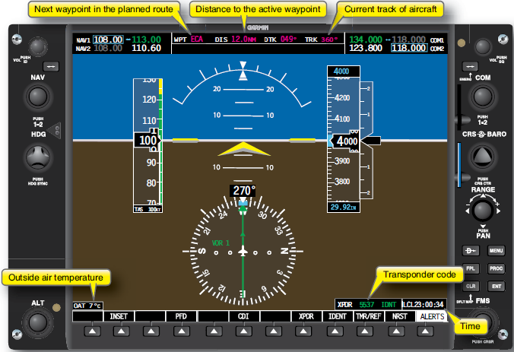
Communication Display
Green: Active Frequency
GPS DATA: Going Airport, 12 nautical miles, bearing is 360 degrees
Navigation
Radio
Frequencies
Autopilot Altitude
Altitude
Indicator
Attitude
Indicator
Vertical Airspeed Indicator
Air Speed
Indicator
Barometric
Pressure
Soft Keys
Horizontal Situation indicator

Slide 6
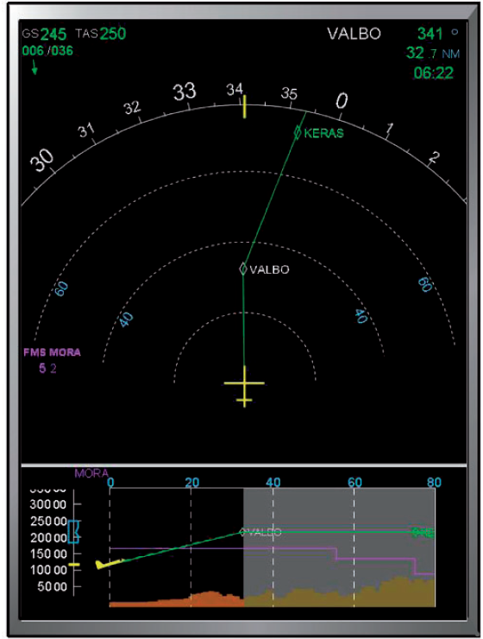
Nearest Waypoint Point Information i.e.
Valvo: 341 deg, distance, estimated time of arrival
Wind Data
Wind direction w.r.t Mag north
340 degrees from North
Max Range of Display 80 NM
Waypoint
Range of Display 60 NM
Green light
Flight Plan

Slide 7
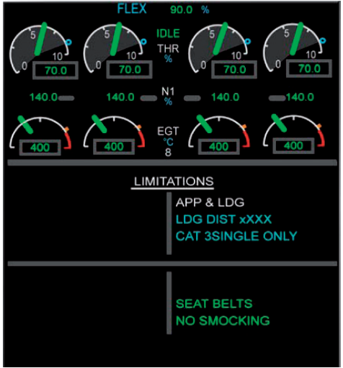
Left Engine
Right Engine
I thnk Throttle % of design max
Rotor Speed(N1)
% of design max rpm
84
Exhaust Gas
Temperature

